Slide 1
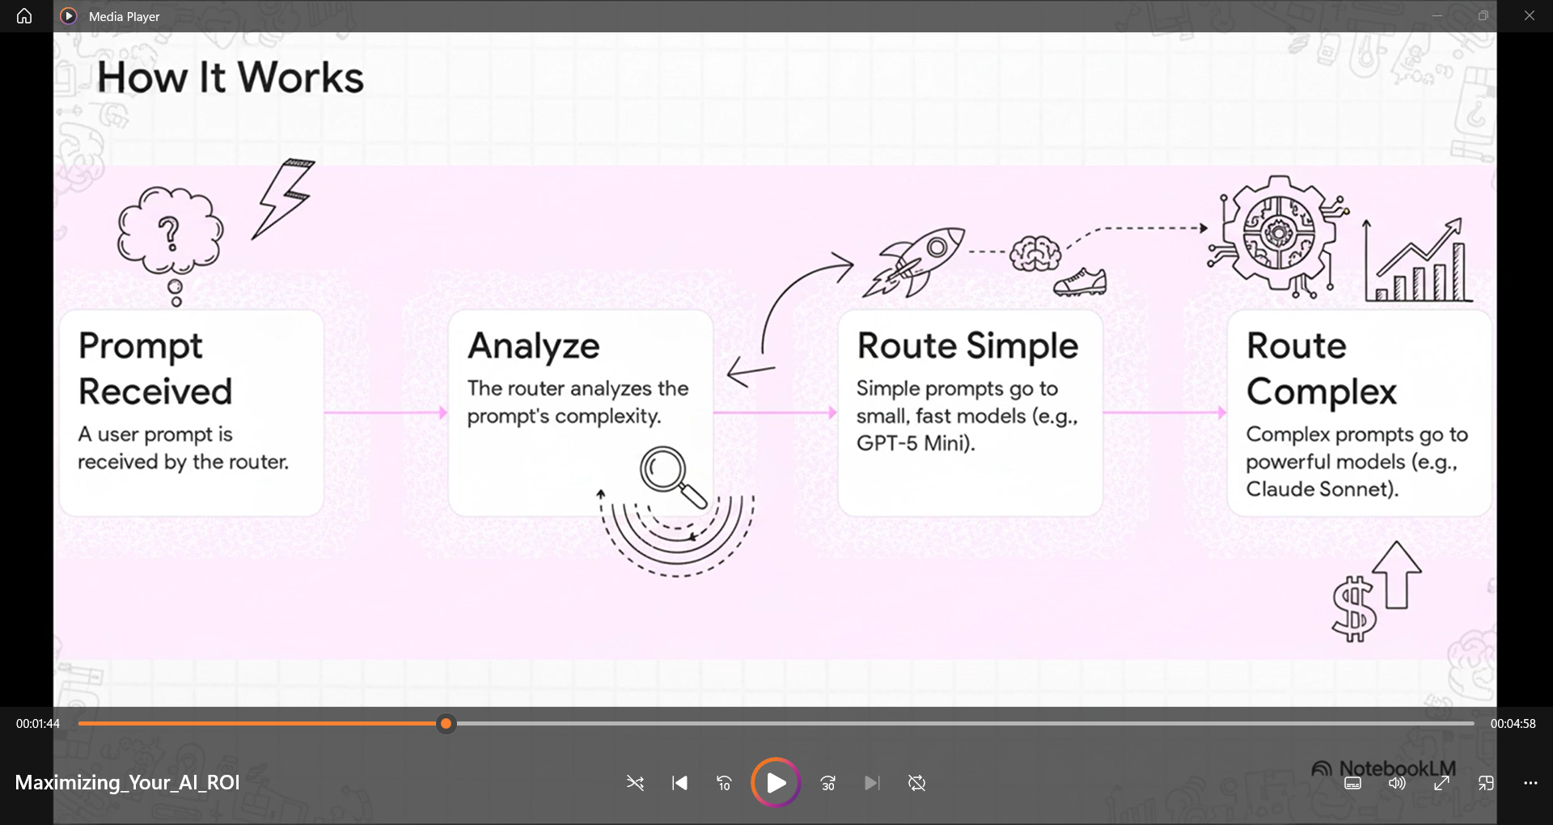
Model Router: Right Model Right Time

Slide 2
AI ROI: Cost & Efficiency Optimization
(Intelligent Router Approach)
Model Router – Routes prompts to the right model based on complexity
Impact: Lower latency & cost; configurable for cost, quality, or balance
Flexibility: Supports non-OpenAI models (e.g., Claude)
Prompt Caching – Identifies repeatable patterns to cut token usage.
Impact: Up to 80% faster TTFT; major cost savings
Fine Tuning – Optimize smaller models for high performance → cost savings.
Batch Processing – 50% cost reduction for large-scale, non-interactive workloads

Slide 3
Pillar 1: Cost & Efficiency Optimization
Model Router: Routes by complexity; configurable for cost/quality/balanced modes; supports agentic scenarios with tools
Prompt Caching: 90% savings per cached token; workload savings 30-70%; up to 85% latency reduction
Fine-Tuning: Smaller models match large model performance at lower cost
Batch Processing: 50% discount for non-interactive, high-throughput workloads

Slide 4
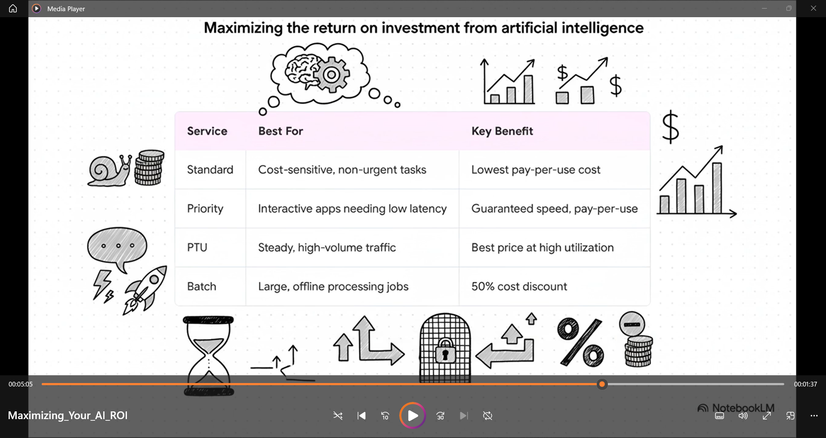

Slide 5
I ROI: Governance & Operational Productivity
(The Control Plane)
Observability & Governance
Guardrails, risk reduction, and visibility for confident deployment
Real-time Cost Transparency
Live cost estimates in Foundry portal → better spend control
Reduced Manual Overhead
Priority Processing minimizes manual reviews & capacity planning → frees engineering time

